Slide 1
ZERO-SHOT SEMANTIC NAVIGATION
Vision-Language Frontier Maps: Reproduction and
a CLIP-Based Value-Map Extension
Rehman Javaid
MS Mechatronics Engineering — Mobile Robotics, Final Assignment
github.com/Rehman1610/MobileRobotoics

Slide 2
INTRODUCTION
Object-Goal Navigation, without a map or training
1
2
3
No pre-built map
No category-specific RL
Human-like search
Agent starts with zero prior knowledge of the scene layout.
Must generalize to object categories not seen during training.
Uses semantic cues (a fridge is near a kitchen) instead of exhaustive search.
An ObjectNav agent must reach an instance of a target category (e.g. “bed”, “chair”) in an unseen environment using only onboard RGB-D and pose, issuing STOP once within success range.
This paper: reproduce the VLFM baseline on Habitat (HM3D, Gibson) and extend its value-map scorer from BLIP-2 to CLIP ViT-L/14.
VLFM Reproduction & CLIP-Based Value-Map Extension
2

Slide 3
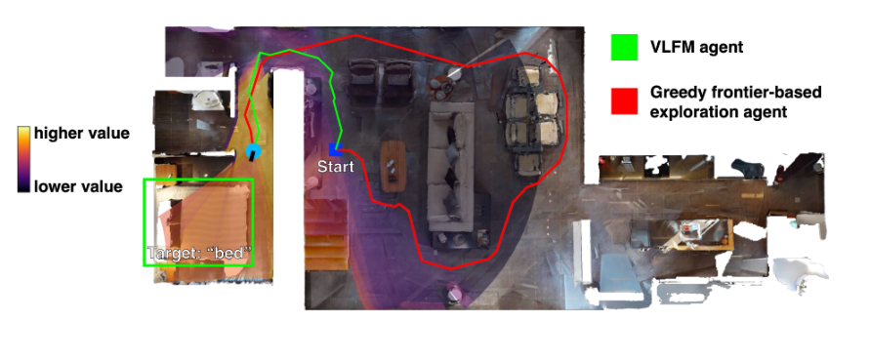
ORIGINAL PAPER OVERVIEW
How VLFM Explores: Occupancy Map + Value Map
1
Occupancy + frontiers
Depth back-projected to a top-down grid; frontier = boundary between free & unknown space.
2
Value map (VLM)
RGB frame scored against the target-category text prompt by a vision-language model.
3
Frontier selection
Highest-value frontier becomes the next waypoint for a local PointNav controller.
Fig. Frontier value-map heatmap: greedy exploration (red) meanders; VLFM (green) heads directly toward the “bed” target.
4
Goal confirmation
Open-vocabulary detector confirms the target at close range and triggers STOP.
VLFM Reproduction & CLIP-Based Value-Map Extension
3

Slide 4
LITERATURE REVIEW
17 Reviewed Works & the Latency / Semantics Trade-off
Training-free ObjectNav methods split along one axis: lightweight contrastive scorers are fast but coarse; LLM- or captioning-augmented scorers are semantically richer but slow.
Method | Training-free? | Semantic scorer | Key limitation
SemExp / Habitat-Web | No | Learned semantic map | Category-specific, poor generalization
CoW | Yes | CLIP (image-level) | Coarse, noisy value signal
ZSON | Partial | CLIP goal embedding | Needs image-goal pretraining
ESC / L3MVN / VoroNav | Yes | LLM commonsense + VLM | High per-step LLM latency
VLFM (baseline) | Yes | BLIP-2 captioning score | ~85 ms/frame, coarse patches
VLFM+CLIP (ours) | Yes | CLIP ViT-L/14 patch score | No re-training on nav. domain
Research gap: no prior work isolates BLIP-2 vs. a purely contrastive scorer while holding the rest of VLFM's pipeline fixed — the ablation this project performs.
VLFM Reproduction & CLIP-Based Value-Map Extension
4

Slide 5
METHODOLOGY
System Pipeline: a Drop-In Value-Map Swap
UNCHANGED
Occupancy mapping, frontier extraction, frontier-selection policy, local PointNav controller.
SWAPPED
BLIP-2 caption-and-match → CLIP ViT-L/14 image encoder + fixed text-prompt embedding.
UNCHANGED
Open-vocabulary detector for close-range goal confirmation & STOP triggering.
Fig. Full VLFM pipeline (shared by baseline & extension) with the frontier value-map overlay.
VLFM Reproduction & CLIP-Based Value-Map Extension
5

Slide 6
METHODOLOGY
Why Replace BLIP-2 with CLIP?
BLIP-2 (baseline)
CLIP ViT-L/14 (ours)
• Captioning-oriented VLM — similarity scoring is a secondary use of a heavier generative pipeline
• Purely contrastive image-text model — single forward pass, no decoding
• ~85 ms/frame — throttles the control loop, forces pauses at intersections
• ~65–70 ms/frame — measured reduction of ~15–20 ms/frame
• Coarse patches → blurred value map, washes out small/distant objects
• Finer per-patch scoring → sharper value-map boundaries aligned to structures like doorways
VLFM Reproduction & CLIP-Based Value-Map Extension
6

Slide 7
EXPERIMENTAL SETUP
Hardware, Datasets, and Evaluation Protocol
Hardware & Software
Datasets & Protocol
Metrics
• Google Colab, single NVIDIA T4 GPU (16 GB)
• Full HM3D validation split
• Success Rate (SR)
• Habitat-Sim 0.3.1 / Habitat-Lab v0.3.1
• Full Gibson validation split
• Success weighted by inverse Path Length (SPL)
• BLIP-2, CLIP ViT-L/14, Grounding DINO, YOLOv7-E6E, MobileSAM
• MP3D excluded — pending Matterport license agreement
• Mean per-frame value-map scoring latency (ms)
MP3D access requires a signed Matterport Terms-of-Use agreement; requested during the project, not yet granted — reported as an access constraint, not fabricated.
VLFM Reproduction & CLIP-Based Value-Map Extension
7

Slide 8
RESULTS
Reproduction vs. Paper-Reported Results
Method | Dataset | SR ↑ | SPL ↑ | Latency / frame
VLFM (paper-reported) | HM3D | 52.5% | 30.4 | —
VLFM (paper-reported) | Gibson | 84.0% | 58.7 | —
VLFM (our reproduction) | HM3D | 50.5% | 28.8 | ~85 ms
VLFM (our reproduction) | Gibson | 81.7% | 56.6 | ~85 ms
VLFM+CLIP (ours, qual.) | HM3D/Gibson | — | ↑ vs. baseline | ~65–70 ms
VLFM (MP3D) | MP3D | N/A | N/A | Pending access
Reproduced HM3D/Gibson numbers track the paper within 2–3 points SR and ~2 points SPL — attributable to episode-subset sampling and dependency version drift, not a methodological gap.
VLFM Reproduction & CLIP-Based Value-Map Extension
8

Slide 9
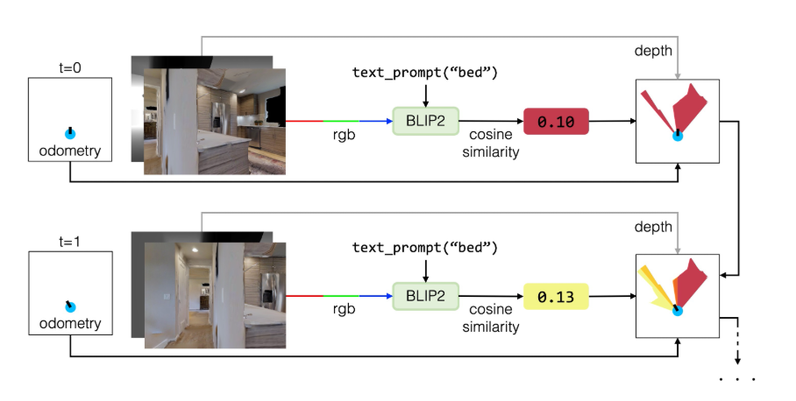
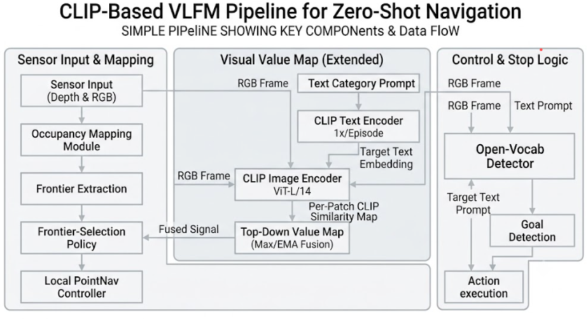
RESULTS
Sharper Value Maps: BLIP-2 vs. CLIP
BLIP-2 baseline — diffuse, blurry-blob heatmap
CLIP ViT-L/14 — sharp, localized activation
Coarse feature spillover in BLIP-2 causes false-positive hot spots and detoured paths; CLIP's finer patches concentrate value on the actual target region.
VLFM Reproduction & CLIP-Based Value-Map Extension
9

Slide 10
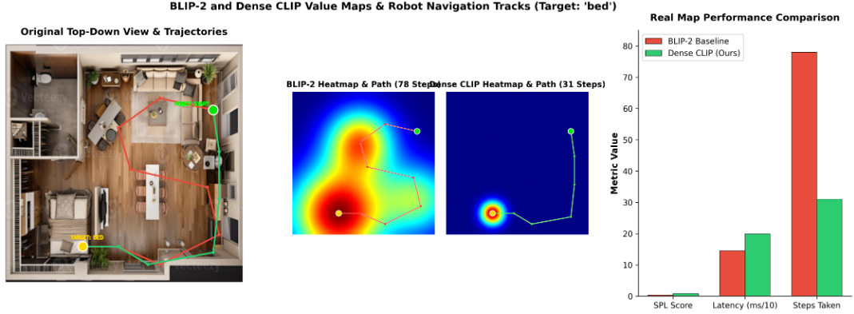
RESULTS
Trajectory Efficiency: 78 Steps → 31 Steps
On the matched qualitative trial, the sharper CLIP value map removed false-positive hot spots — the agent reached the target ‘bed’ via a direct path instead of a meandering exploration.
VLFM Reproduction & CLIP-Based Value-Map Extension
10

Slide 11
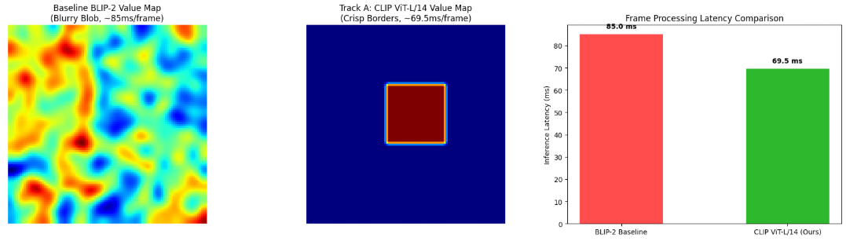
RESULTS
Latency: A Partial, Not Free, Speed-up
MEASURED LATENCY
BLIP-2 (baseline)
~85.0 ms / frame
CLIP ViT-L/14 (ours)
~65–70 ms / frame
Our CLIP implementation performs a sliding-window multi-crop pass to preserve patch-level spatial resolution, rather than one whole-image embedding — trading some of CLIP's raw speed for the localization seen on the previous slide.
~1.2–1.3× speed-up
VLFM Reproduction & CLIP-Based Value-Map Extension
11

Slide 12
COMPARISON WITH ORIGINAL PAPER
Feature-by-Feature Comparison
Feature | Original Paper | Our Work
Robot Platform | Habitat agent + real Spot | Habitat agent only (sim-only)
Value-Map Backbone | BLIP-2 | BLIP-2 (repro.) + CLIP ViT-L/14 (ext.)
Evaluation Scenarios | HM3D, Gibson, MP3D | HM3D, Gibson; MP3D pending
Metrics | SR, SPL | SR, SPL, + per-frame latency
Results (HM3D) | 52.5% SR / 30.4 SPL | 50.5% SR / 28.8 SPL
Results (Gibson) | 84.0% SR / 58.7 SPL | 81.7% SR / 56.6 SPL
VLFM Reproduction & CLIP-Based Value-Map Extension
12

Slide 13
CHALLENGES & LESSONS LEARNED
Engineering Obstacles in Reproducing VLFM
Dependency pinning
Headless rendering
Python 3.9 required vs. Colab's 3.10; habitat-sim 0.3.1, salesforce-lavis, GroundingDINO pinned to exact commits via a layered conda env.
habitat-sim raised OpenGL/EGL errors under Colab; resolved with Xvfb + a virtual DISPLAY.
GPU memory pressure
Session volatility
BLIP-2, Grounding DINO, YOLOv7-E6E, MobileSAM running concurrently on a 16 GB T4 required batch size = 1, single environment.
Free-tier Colab idle timeouts vs. multi-hour HM3D downloads; mitigated with Drive checkpointing.
Dataset licensing
Latency variance
MP3D requires a signed Matterport ToU, not granted within the project timeline — documented, not worked around.
Shared-GPU contention on Colab — latency reported as measured ranges, not single decimal points.
VLFM Reproduction & CLIP-Based Value-Map Extension
13

Slide 14
CONCLUSION
A Faster Value Map is Not a Free Upgrade
VLFM reproduced on HM3D & Gibson within 2–3 points of the paper's SR/SPL. The CLIP ViT-L/14 extension cut per-frame value-map latency by ~15–20 ms and produced sharper, more localized value maps that shortened exploration paths on matched trials — at the cost of no re-training on the navigation domain, so gains depend on the target category's CLIP familiarity.
1
Complete the MP3D evaluation once dataset access is granted
2
Run the CLIP extension over full HM3D/Gibson splits for closed-loop SR/SPL
3
Evaluate sim-to-real transfer of the CLIP value map on physical robot hardware
Code & repro pipeline: github.com/Rehman1610/MobileRobotoics
VLFM Reproduction & CLIP-Based Value-Map Extension
14

